Slide 1



Our Profile

Slide 2

Inside
Who we are.
What we do.
How we do it.
Where we are.

Slide 3
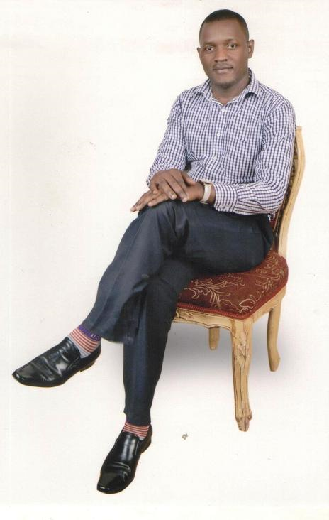
Gawera Investments (U) Ltd was founded in 2010 by a team of seasoned Human Resource and Business Development professionals with one simple objective of identifying and providing Ugandans with choice employment opportunities Internationally through the provision of high end people solutions. This desire was fueled by the VISION of contributing to a world where individuals are engaged in gainful employment opportunities.
Our philosophy is that choice employment opportunities contribute to solid, secure and happy communities.

Slide 4
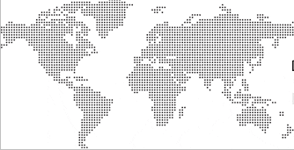
Global Deployment
USA
Uganda
Kenya
Somalia
Djibouti
United Arab Emirates
Our flawless experience as professional suppliers of quality human capital and construction equipment has enabled us build a steady and trusted brand across the world. We offer our customers integrated business solutions backed by expertise and comprehensive understanding of their home markets. – and that is why every time our customers are in need of quality, trusted, reliable solutions – its our brand that comes to mind.
Labor Export

Slide 5

Corporate Snapshot
Founded in 2010,
Market leader for Human Capital, Food and Construction Equipment leasing,
Global presence in over 6 countries,
More than 300 individuals placed ,
Over 10 industries,
Over 20 clients,

Slide 6

Our Business Promise
Provide the highest standard of service in everything that we do,
Treat each customer with dignity, honesty, and integrity,
Continuously invest in innovating creative solutions for our customer needs,
Put customer needs above all else,
To achieve this through strict adherence to our values, which are;
Customer centric service, Equal opportunity, Integrity, Quality,
Confidentiality, Professionalism,

Slide 7
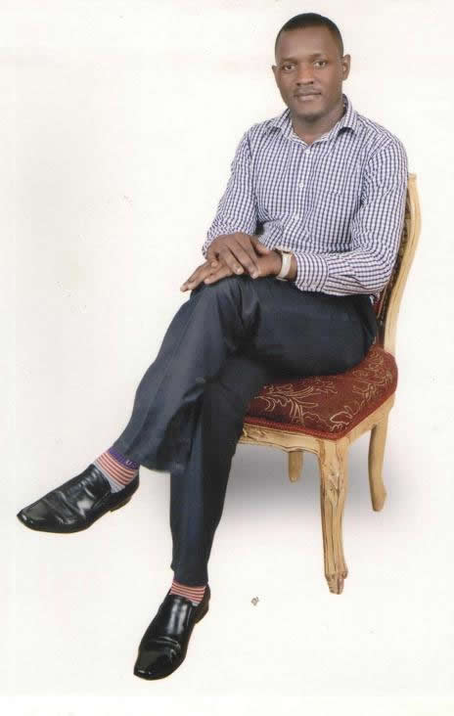
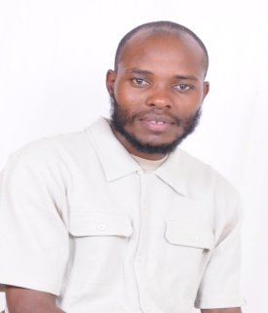
Meet the Team
Solomon is the founder and Director of Gawera Investments. He boasts of over 15 years of post qualification experience practicing at both local and international levels. He brings to the team a wealth of knowledge in strategic business development. To Solomon, an ongoing relationship with strategic partners is a great thing from a customers point of view.
Ronald is the Business Development Coordinator for Gawera Investments. His goal is to build strong work relations with GI’s clientele but to also create new business leads. His people skills and experience working with diverse organizations make him the right match for this role. He prides in being part of lasting solutions to organizational challenges.

Slide 8
Organizational Structure
CEO
Finance &
Admin
Business Dev - Co.
HR Specialist
Support staff
Sales Force
Associates

Slide 9
RECRUITMENT
Drivers, Security,
House help, Doctors
What we do
EQUIPMENT
LEASING
FOOD
CONSTRUCTION

Slide 10

Our Methodology
At Gawera Investments, one of the flag services that we offer is Labor Export. We do work with globally positioned individuals and organizations seeking to hire talented human capital for their respective organizations.
To help them bridge this gap,
We identify talented individuals and keep their particulars in a database.
Conduct background/criminal checks for all candidates before introducing them to employers. We also conduct background checks for all potential employers to attest their legitimacy.
With the consent of the individuals, we introduce their details to potential employers and also ensure that the final placement is done.

Slide 11

What sets us apart
Our client’s business is our business. This is why before we do anything, we focus on what sets us apart - gaining a thorough understanding of our client’s needs from the inside. This helps us discover the attitudes and strategic intentions of the organization before providing the right solution.
We also follow up with the clients to find out how our solutions have impacted business performance and provide the necessary after sales help where applicable.
At Gawera Investments, our customer centric approach enables us to always strive to surpass the needs of our partners in every assignment that we undertake.

Slide 12
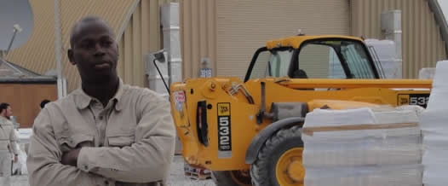
Ask us for Testimonials
I am extremely impressed with the work that Gawera Investments is doing. Staff have a professional touch and they are thorough. The career mapping that I received enabled me gain direction and what it takes to be competitive. Now I am employed and learning very fast at my new job. I would recommend any organization that is looking for fine candidates or any candidate that needs a placement to visit GI. xxxx

Slide 13






Our Global Clientele
:
We have built strong partner relationships with major organizations in order to bring the right solutions to the right place at the right time. Partnership with strong global brands has continued to redefine our level of commitment and trust.

Slide 14

Our Global Contacts
UGANDA | KENYA | SOMALIA | DJIBOUTI | UAE
PO Box 72226 Clock tower Kla +256 773512039 +256 706273427 Email: gawera.investments@yahoo.com | +254 723232592 Nairobi | +252 699294959 Mogadishu | +253 77188426 Djibouti | +971 554576257 Internet city

